Slide 1
Big Data module

Slide 2
Part 1: Big Data

Slide 3
Big Data according to wikipedia
“Big data is a field that treats ways to analyze, systematically extract information from, or otherwise deal with data sets that are too large or complex to be dealt with by traditional data-processing application software. Data with many fields (columns) offer greater statistical power, while data with higher complexity (more attributes or columns) may lead to a higher false discovery rate.Big data was originally associated with three key concepts: volume, variety, and velocity.”

Slide 4
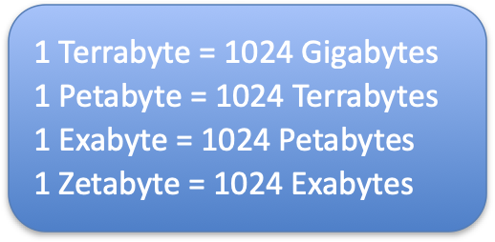
What is Big Data ?
Four Vs of Big Data
Volume: Extremely large volumes of data
Variety: Various forms of data – structured, semi-structured and unstructured
Velocity: Real time, batch, streams of data
Veracity/Variability: Inconsistent, sometimes inaccurate, varying data

Slide 5







Big Data Technology

Slide 6
Landmarks
Each character stored in a computer requires approximately four bytes when stored in the uncompressed utf-8 format.
In English, the average word length is 5.1 characters (WolframAlpha). A word is therefore on average 20.4 bytes
Assuming that we speak an average of 1963 words per day.
For 7.4 billion human beings making up the world's population (Wikipedia), the total number of words spoken every day would weigh 292.5 TB

Slide 7

Landmarks
Facebook generates 4 petabytes of new data per day
The Square Kilometer Array radio telescope will generate 7 petabytes of raw data per second, so 604.8 exabytes per day. It's still 151,200 times Facebook.
As for the web, it is estimated that the data it will generate in 2025 is 60 zettabytes.

Slide 8
From data to business
How to store them, filter them, analyze them?
Then when can we talk about big data?
For example on the scale of Facebook 100 GB represents a small volume of data.
In this course, we are considering that we make big data when the quantity of data exceeds the ability of a machine to store and analyze it in an acceptable time. ”

Slide 9
From data to business
A good indicator: compare the data size to the available RAM.
But it would be reductive to consider that it is enough to store large data to make big data
=> without analysis the storage is useless
A large volume of data results in a large amount of computational resources required to analyze that data

Slide 10
Evolution of Big Data
Big data is a result of technological advances and innovations made in the past several decades
Before computers were invented, data was being generated and collected, but challenge was in storing and analyzing data
Inventions in digital storage, Internet, and computing models like virtualization and cloud computing have transformed the data landscape
Reduction in costs of storage and computing power have led to the beginning of the big data era

Slide 11
Evolution of Big Data: Timeline
1960s: When computers were adopted by commercial industries, data was stored in flat files with no data structure imposed
1970s: Relational data model was invented, triggering the popularity of RDBMS databases and the structured query language SQL
1990s: Data warehouses were commercialized to gain insights from data using only a subset of huge volumes of transactional data
2000s: Explosion of Internet brought the need to store unstructured data from web, including audio, video, images and metadata

Slide 12
Evolution of Big Data: New technologies
NOSQL databases: Not Only SQL databases, enables high performance processing of large scale data
Hadoop: A software ecosystem that enables massively parallel computations distributed across thousands of commodity servers in a cluster
Cloud computing: Allows massive-scale complex computations without the need to maintain expensive hardware and software

Slide 13
Source of Big Data
Social media: Messages and information shared between virtual communities via blogs, forums, tweets, Facebook posts, LinkedIn posts, etc.
Machine-generated data: Data generated without human intervention by hardware, software, medical devices
Business transactions: Data describing business events and relationships between different entities and a business
IOT: Devices connected to the Internet that communicate with each other and produce huge amounts of data and information
Sensors: Measuring devices that capture physical quantities and change them into signals

Slide 14
Format of Big Data
Structured: Data that has a defined length and format. Examples are numbers, words, dates. Easy to store and analyze. Often managed using SQL
Semi-structured: Between structured and unstructured, does not conform to a specific format but is self-describing involving simple key-value pairs. Examples are EDI, SWIFT and XML.
Unstructured: Data that does not follow a specific format. Examples are audio, images, text messages, X-Ray images etc.

Slide 15
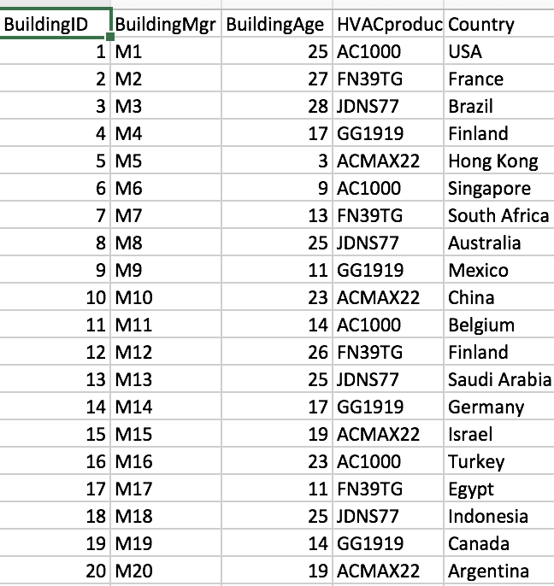
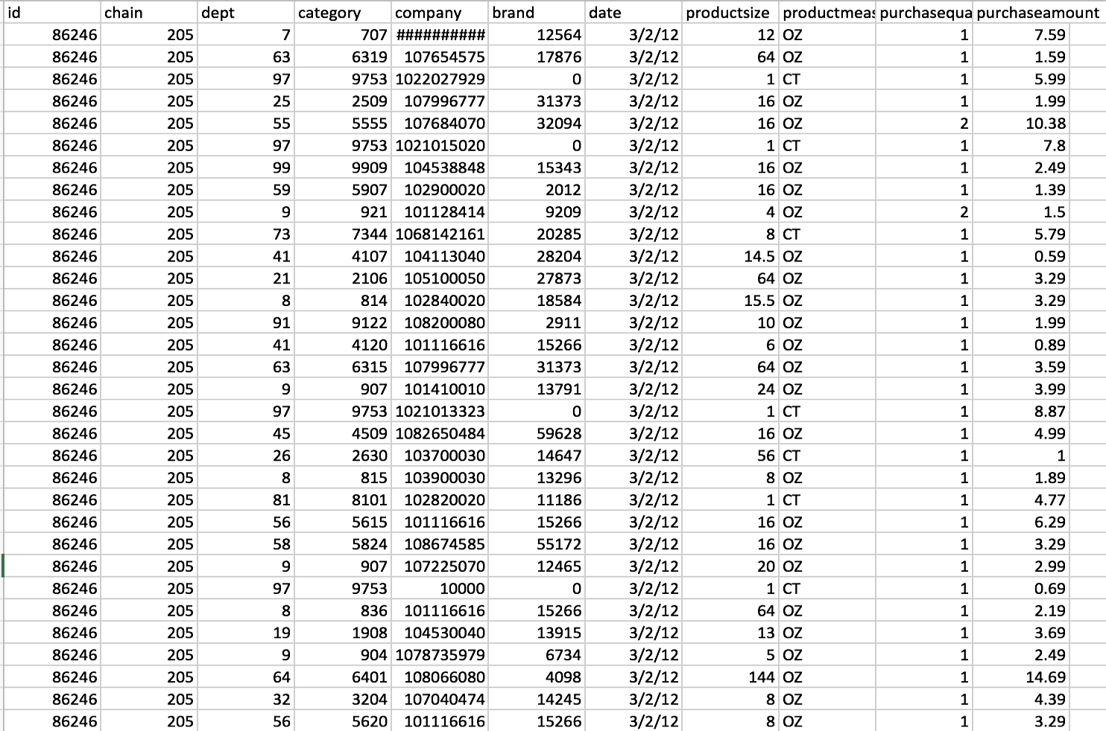
Examples of Structured and Machine generated Big Data
Sensor data, web log data, point of sale data, financial data

Slide 16
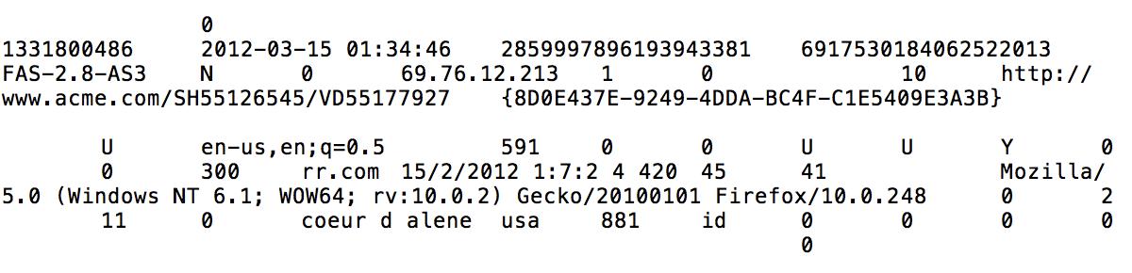
Examples of Structured and human generated Big Data
Click stream data, website input data, gaming related data Clickstream data is an information trail that a user leaves behind while visiting a website. Typically captured in semi-structured web log files.

Slide 17
Examples of Unstructured and human generated Big Data
Social media data, mobile data, website content, corporate textual data
Every 60 seconds ….
Search engine Google serves more that 694,445 queries
6,600+ pictures are uploaded on Flickr
600+ videos are uploaded on YouTube videos, amounting to 25+ hours of content
695,000 status updates, 79,364 wall posts and 510,040 comments are published on Social Networking site Facebook

Slide 18
Summary
Big data defined by four Vs: Volume, velocity, variety and veracity
Sources of big data include machine generated data, business transaction data, social media data, IOT and sensors
Three formats of big data: Structured, semi-structured and unstructured
Hadoop ecosystem, NoSQL databases and cloud services are technologies supporting Big Data processing and analysis.
Big data analytics is used to derive insights from the data and is what provides value to the data

Slide 19
Part 2 From parallel computing to distributed computing

Slide 20
Difference between Parallel Computing and Distributed Computing
Parallel Computing:
In parallel computing multiple processors performs multiple tasks assigned to them simultaneously.
Memory in parallel systems can either be shared or distributed. Parallel computing provides concurrency and saves time and money.

Slide 21
#!/usr/bin/python
import thread
import time
# Define a function for the thread
def print_time( threadName, delay):
count = 0
while count < 5:
time.sleep(delay)
count += 1
print "%s: %s" % ( threadName, time.ctime(time.time()) )
# Create two threads as follows
try:
thread.start_new_thread( print_time, ("Thread-1", 2, ) )
thread.start_new_thread( print_time, ("Thread-2", 4, ) )
except:
print "Error: unable to start thread"
while 1:
pass
Thread-1: Thu Jan 22 15:42:17 2009
Thread-1: Thu Jan 22 15:42:19 2009
Thread-2: Thu Jan 22 15:42:19 2009
Thread-1: Thu Jan 22 15:42:21 2009
Thread-2: Thu Jan 22 15:42:23 2009
Thread-1: Thu Jan 22 15:42:23 2009
Thread-1: Thu Jan 22 15:42:25 2009
Thread-2: Thu Jan 22 15:42:27 2009
Thread-2: Thu Jan 22 15:42:31 2009
Thread-2: Thu Jan 22 15:42:35 2009

Slide 22
Difference between Parallel Computing and Distributed Computing
Distributed Computing:
Multiple autonomous computers which seems to the user as single system.
There is no shared memory and computers communicate with each other through message passing.
A single task is divided among different computers.

Slide 23
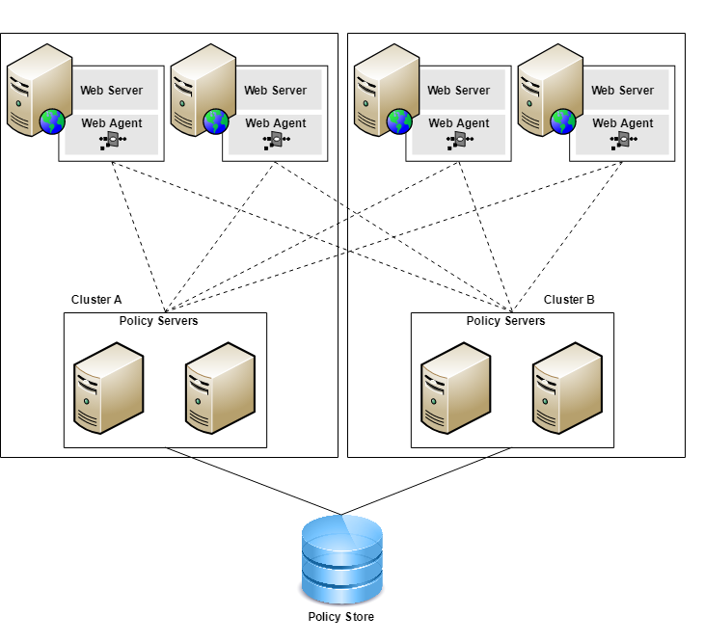
From parallel computing to distributed computing
Distributed model
allows greater fault tolerance
when a node of the cluster undergoes a failure, it is enough to assign the task that it was processing to another node
whereas in the parallel model the machine on which the computation is executed

Slide 24
From parallel computing to distributed computing
The fault tolerance policy requires being able to recreate the state of the failed node. This is all the more complex because we are talking about a large volume of data.
This question arises for each new application => the developers invented a generic framework: the MapReduce

Slide 25
Part 3: Map reduce

Slide 26
Map Reduce
First step : every chunk is going to be assign to a machine in the cluster, thus allowing them to be processed in parallel
Second step: aggregate all the intermediate results obtained for each chunk to construct the final result.

Slide 27
Functional inspiration
MapReduce is very largely inspired by this programming paradigm and more particularly from the operators of lists map and reduce. Map and reduce are generic operators and their combination therefore allows to model a lot of problems.

Slide 28
Functional inspiration
In functional programming : 1. Map consists in applying the same function to all the elements of the list : map(f)[x0, ..., xn] = [f(x0, ...,f(xn)]
map(*4)[2, 3, 6] = [8, 12, 24] 2. Reduce applies a function recursively to a list and returns a single result : reduce(f)[x0, ..., xn] = f(x0, f(x1, f(x2, ...)))
reduce(+)[2, 3, 6] = (2 + (3 + 6)) = 11
Map and reduce are generic operators and their combination therefore allows to model a lot of problems.

Slide 29
Functional inspiration
The last ingredient, fundamental for the automation of parallelization, is that the set of data is represented in the form of pairs (key, value)
General operation:
All the data to be processed is divided into several batches or subsets
The MAP operation is applied to each batch. Transformation of the batch (key, value) into a list of new pairs (key, value) constituting intermediate results
Before being sent to the REDUCE step, the intermediate results are grouped and sorted by key. This is the step of SHUFFLE and SORT.
Finally, the REDUCE step consists in applying the reduce operation, specified for our problem, to each key. It aggregates all the intermediate results.

Slide 30
MapReduce on pairs (key, value)
To make the operation of MapReduce more concrete, we are going to illustrate it with "WordCount!" the typical example of MapReduce
Let us take as input a collection of textual documents: the objective of Wordcount is to calculate the number of occurrences of each word in the collection.
If You can store your entire collection in a single file; so, this is really not a difficult problem and the few lines of code below can address this problem.
from collections import defaultdict
def wordCount(text):
counts=defaultdict(int)
for word in text.split():
counts[word.lower()] +=1
return counts

Slide 31
MapReduce on pairs (key, value)
Note that we use here a dictionary which is a collection of elements of type (key, value). The key corresponds to the word and the value an integer corresponding to its number of occurrences.
If your text is large, even very, very large, like the Wikipedia collection which contains about 27 billion words (source: Wikipedia), this sequential solution will not be enough and it is necessary to carry out this counting in a distributed manner .
This is where MapReduce comes

Slide 32
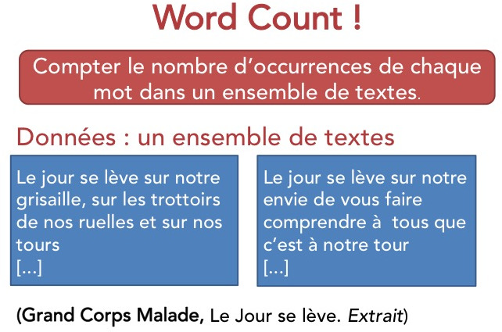
MapReduce on pairs (key, value)
We are going to work on two extracts from the text of the song "Le Jour se lève" by Grand Corps Malade. We are far from the 27 billion words of Wikipedia but the objective is to illustrate the principle of MapReduce

Slide 33
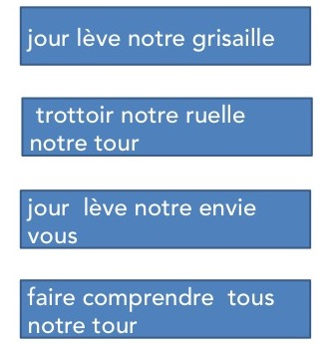
MapReduce on pairs (key, value)
Our input data has been split into different fragments and a simplification operation has been applied to each fragment to remove punctuation characters, transform each word into its singular
We can very easily represent these fragments in the form of pairs (key, value), taking as key the name of the file and as value the character string corresponding to the textual content of the file.

Slide 34
MapReduce on pairs (key, value)
We can very easily represent these fragments in the form of pairs (key, value), taking as key the name of the file and as value the character string corresponding to the textual content of the file.
D1 = {"./lot1.txt" : "jour lève notre grisaille"}
D2 = {"./lot2.txt" : "trottoir notre ruelle notre tour"}
D3 = {"./lot3.txt" : "jour lève notre envie vous"}
D4 = {"./lot4.txt" : "faire comprendre tous notre tour"}

Slide 35
MapReduce on pairs (key, value)
The way in which we responded to the problem sequentially directs us quite naturally towards the choice of taking the words of the text as keys.
The next step is to write the code of the map : - it must return a list of pairs (key, value). In the case of WordCount, - the map operation will therefore decompose the text of the fragment supplied as input - it will generate a pair for each word (word, 1). def map(key,value):
intermediate=[]
for word in value.split():
intermediate.append((word, 1))
return intermediate

Slide 36
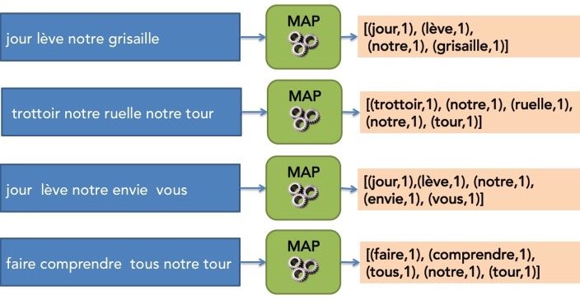
MapReduce on pairs (key, value)
So we now have everything we need for the MAP step of MapReduce which consists in applying the map operation to each fragment in parallel as shown in the figure below.

Slide 37
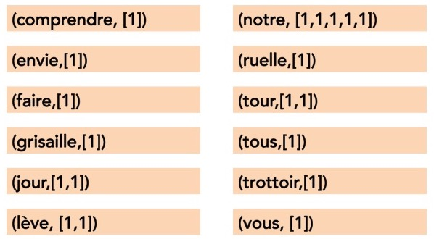
MapReduce on pairs (key, value)
At the end of the MAP step, so we have several lists of pairs (key, value).
At the stade let’s supposed we are able to group and sort by key intermediate results. It corresponds to the Shuffle and sort step.
This step is entirely managed by the MapReduce execution framework, in a distributed manner, and it is therefore legitimate not to detail it further here.

Slide 38
MapReduce on pairs (key, value)
We now have at our disposal a set of pairs (key, list_of_values). We now have to write the code for the reduce operation, according to the scheme imposed by MapReduce. For WordCount, the reduce operation will therefore just consist in summing all the values ​​of the list associated with a key. We can write this again very simply in python.
def reduce(key, values):
result = 0
for c in values:
result = result +c
return (key, result)

Slide 39
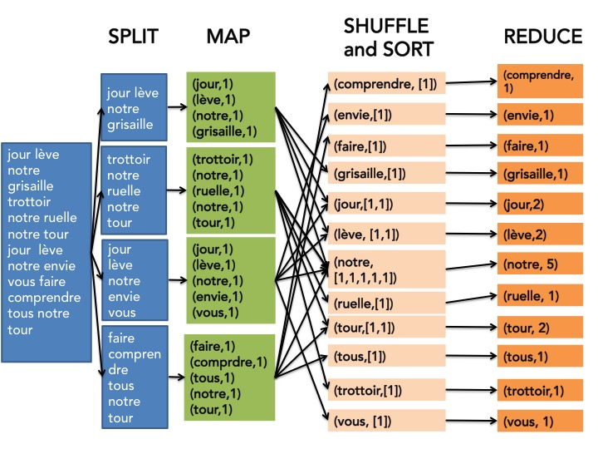
MapReduce on pairs (key, value)
The MapReduce's REDUCE step can therefore be applied. It consists in applying the operation reduce to each pair (key, list_of_values) in parallel.

Slide 40
MapReduce on pairs (key, value)
The MapReduce approach for distributed computation consists in reformulating its problem in parallelizable functions with a relatively constrained diagram All this looks very good on paper, but what about the concrete implementation in a Big Data context, that is to say on a cluster of machines? How are the calculations organized and distributed?

Slide 41
To sum up MapReduce
The generalization of the divide-and-conquer algorithm design paradigm to the distributed framework.
A programming model based on the combination of two simple functions, map Reduce, inspired by functional programming.
An execution framework supporting the deployment and distribution of calculations on a cluster.
The role of distributed application developers is therefore to think in MapReduce:
Choose a way to split the data so that the MAP operation is parallelizable
Choose the key to use for the targeted problem.
Write the function code for the MAP operation.
Write the function code for the REDUCE operation.

Slide 42
Part 4: Hadoop

Slide 43
Hadoop
We have seen the principles of the MapReduce programming model.
Return to the Big Data context in which it has all its interest because it allows the scaling up of processing on large volumes of data.
To do this, it must be associated with a dedicated software infrastructure. The challenges of distributed computing:
the optimization of disk and network transfers by limiting data movement (data locality),
scalability to allow the power to be adapted as needed (scalability),
and finally fault tolerance (embracing failure).

Slide 44

History of Hadoop
Hadoop's name comes from a stuffed elephant owned by creator Doug Cutting's daughter.
In 2002 Doug Cutting and Mike Cafarella, two engineers, decided to tackle the scaling up of an open source search engine. The goal was to make it capable of indexing and searching web-sized collections. This is Project Nutch.
For this, they are inspired by two research articles published by Google Labs:
The first article describes Google file system, a proprietary distributed file system developed by Google and allowing large volumes of data to be stored reliably on clusters.
The second presenting the MapReduce programming model.
The Nutch architecture is therefore based on a distributed file system and on MapReduce. It will give rise to the Hadoop project initiated in 2006. He joined the Apache Foundation in 2008

Slide 45

What is Hadoop ?
Not a single application but a whole open source ecosystem
Designed for distributed storage and computation
Design goal :
Scale horizontally by adding more hardware
Batch oriented : slow startup, maximum throughput
Optimize Disk I/O throughput
Sweet spot : long-running jobs processing data in parallel
Core components :
HDFS
MapReduce
YARN
Notes:
Why?
-Storage – Since data is very large, so storing such huge amount of data is very difficult.
-Security – Since the data is huge in size, keeping it secure is another challenge.
-Analytics – most of the time we are unaware of the kind of data we are dealing with. So analyzing that data is even more difficult.
Data Quality – In the case of Big Data, data is very messy, inconsistent and incomplete.
Discovery – Using a powerful algorithm to find patterns and insights are very difficult.
Hadoop :
No specific schema Stores huge files as they are (raw) without specifying any schema.
-Reliable
-High availability – In Hadoop data is highly available despite hardware failure. If a machine or hardware crashes, then we can access data from another path.
-Fault Tolerance – Apache Hadoop is highly Fault-Tolerant - 3 replica
-Scalability – Hadoop is highly scalable, as one can add the new hardware to the nodes.
-Economic – Hadoop runs on a cluster of commodity hardware which is not very expensive. We do not need any specialized machine for it.

Slide 46

What is a cluster ?
Cluster: set of computers (nodes) that can:
see each other
talk with each other
share a pool of resources (CPU, memory)
sometimes share storage
Allow to scale horizontally
Comprised of different node types:
master nodes: manage the overall state and activities
worker nodes: execute the computation tasks following the masters’ instructions
MA
MB
W1
W2
W3
W4
Notes:
Why?
-Storage – Since data is very large, so storing such huge amount of data is very difficult.
-Security – Since the data is huge in size, keeping it secure is another challenge.
-Analytics – most of the time we are unaware of the kind of data we are dealing with. So analyzing that data is even more difficult.
Data Quality – In the case of Big Data, data is very messy, inconsistent and incomplete.
Discovery – Using a powerful algorithm to find patterns and insights are very difficult.
Hadoop :
No specific schema Stores huge files as they are (raw) without specifying any schema.
-Reliable
-High availability – In Hadoop data is highly available despite hardware failure. If a machine or hardware crashes, then we can access data from another path.
-Fault Tolerance – Apache Hadoop is highly Fault-Tolerant - 3 replica
-Scalability – Hadoop is highly scalable, as one can add the new hardware to the nodes.
-Economic – Hadoop runs on a cluster of commodity hardware which is not very expensive. We do not need any specialized machine for it.

Slide 47
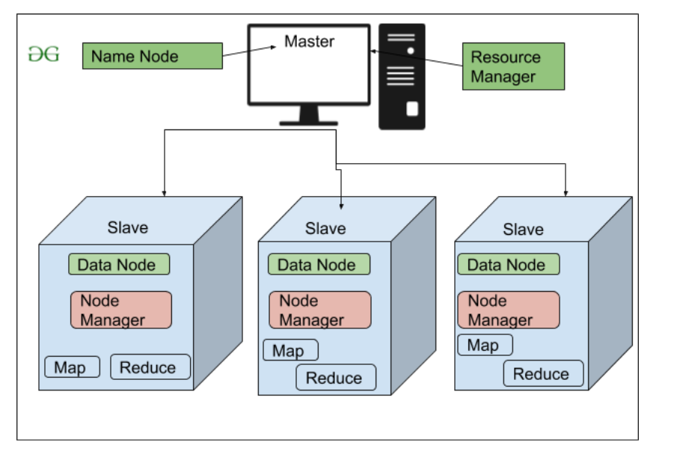
Hadoop Cluster
Notes:
Why?
-Storage – Since data is very large, so storing such huge amount of data is very difficult.
-Security – Since the data is huge in size, keeping it secure is another challenge.
-Analytics – most of the time we are unaware of the kind of data we are dealing with. So analyzing that data is even more difficult.
Data Quality – In the case of Big Data, data is very messy, inconsistent and incomplete.
Discovery – Using a powerful algorithm to find patterns and insights are very difficult.
Hadoop :
No specific schema Stores huge files as they are (raw) without specifying any schema.
-Reliable
-High availability – In Hadoop data is highly available despite hardware failure. If a machine or hardware crashes, then we can access data from another path.
-Fault Tolerance – Apache Hadoop is highly Fault-Tolerant - 3 replica
-Scalability – Hadoop is highly scalable, as one can add the new hardware to the nodes.
-Economic – Hadoop runs on a cluster of commodity hardware which is not very expensive. We do not need any specialized machine for it.

Slide 48

The Hadoop Ecosystem HDFS
In Hadoop, the storage architecture is a master-slave architecture.
The master node called name node is a “big dictionary”
=> contains and stores all file names and blocks as well as their location in the cluster
Another machine, called secondary name node serves as a “backup namenode” in the event of failure of the master node and its role is therefore to make regular backups of the directory.
The other nodes, the slaves, are the storage nodes as such. These are the data nodes whose role is to manage local storage operations (creation, deletion and replication of blocks) on the instruction of the name node.
Notes:
What is throughput in Hadoop?
The amount of work done in a unit time is Throughput. Because of bellow reasons HDFS provides good throughput:
Write once / read many: data is never modified, simplify the data coherency and increase throughput. It simplifies the data coherency issues as the data written once, one can not modify it. Thus, provides high throughput data access.
Hadoop works on Data Locality principle. In Hadoop, HDFS stores datasets. Datasets are divided into blocks and stored across the datanodes in Hadoop cluster. When a user runs the MapReduce job then NameNode sends this MapReduce code to the datanodes on which data is available related to MapReduce job.
Processing is done in parallel
Computation moves to data (et pas l’inverse), ce qui augmente la vitesse de production

Slide 49
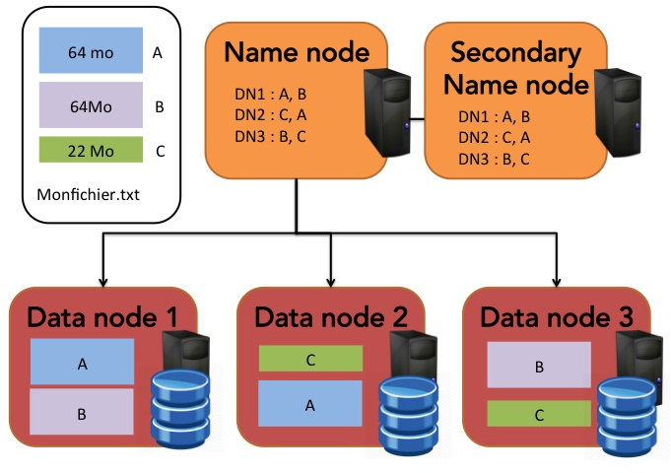

Slide 50

HDFS: File formats
Chose the format depending on your application
Data structure will change ?
Write performance ?
Full read performance ?
Partial read performance ?
Notes:
Csv
JSON sur chaque ligne
do not support block compression, thus compressing a CSV file in Hadoop often comes at a significant read performance cost
Block level compression : can compress the contents of the file while also maintaining the ability to split the file into segments for multiple map tasks
columnar file storage
this means that instead of just storing rows of data adjacent to one another you also store column values adjacent to each other. So datasets are partitioned both horizontally and vertically.
Hive and Spark which tend to just read segments of records

Slide 51
The Hadoop Ecosystem HDFS
Hadoop Distributed File System
Files are split into blocks, spread between machines
Replication is handled automatically
Redundant access
HDFS is the core storage layer for most Hadoop components
Notes:
What is throughput in Hadoop?
The amount of work done in a unit time is Throughput. Because of bellow reasons HDFS provides good throughput:
Write once / read many: data is never modified, simplify the data coherency and increase throughput. It simplifies the data coherency issues as the data written once, one can not modify it. Thus, provides high throughput data access.
Hadoop works on Data Locality principle. In Hadoop, HDFS stores datasets. Datasets are divided into blocks and stored across the datanodes in Hadoop cluster. When a user runs the MapReduce job then NameNode sends this MapReduce code to the datanodes on which data is available related to MapReduce job.
Processing is done in parallel
Computation moves to data (et pas l’inverse), ce qui augmente la vitesse de production

Slide 52
HDFS: File formats
 | Text file | Gzipped text | SequenceFile | RCFile | ORC | Avro | Parquet
Compressed |  | ✓ | ✓ | ✓ | ✓ | ✓ | ✓
Splittable | (✓) |  | ✓ | ✓ | ✓ | ✓ | ✓
Columnar |  |  |  | ✓ | ✓ |  | ✓
Non-scalar type | (✓) | (✓) | (✓) | ✓ | ✓ | ✓ | ✓
Embedded schema |  |  |  |  | ✓ | ✓ | ✓
Interoperability | +++++ | ++++ | ++ | + | + | +++ | ++
Notes:
Csv
JSON sur chaque ligne
do not support block compression, thus compressing a CSV file in Hadoop often comes at a significant read performance cost
Block level compression : can compress the contents of the file while also maintaining the ability to split the file into segments for multiple map tasks
columnar file storage
this means that instead of just storing rows of data adjacent to one another you also store column values adjacent to each other. So datasets are partitioned both horizontally and vertically.
Hive and Spark which tend to just read segments of records

Slide 53

The Hadoop Ecosystem MapReduce
Distributed and redundant computation
Execute algorithms following the “Map-Reduce” paradigm
Computation is divided into tasks
Uses data from HDFS and (usually) stores into HDFS
Notes:
Why Hadoop MapReduce?
When we store huge amount of data in HDFS, the first question arises is, how to process this data? Transferring all this data to a central node for processing is not going to work.
And we will have to wait forever for the data to transfer over the network.
Challenges before MapReduce:
Costly – All the data (terabytes) in one server expensive / hard to manage
Time-consuming – if one machine
MapReduce overcome these challenges:
Cost-efficient – It distribute the data over multiple low config machines.
Time-efficient – If we want to analyze the data. We can write the analysis code in Map function. And the integration code in Reduce function and execute it. Thus, this MapReduce code will go to every machine which has a part of our data and executes on that specific part. Hence instead of moving terabytes of data, we just move kilobytes of code. So this type of movement is time-efficient.
Distributed: calcul parallel
Redundant: si une tache échoue elle est relancée
Use data from HDFS and store to HDFS

Slide 54



The Hadoop Ecosystem High-level languages
MapReduce is a low-level paradigm
Hard to express complex business problems as MapReduce functions
High-level data processing frameworks to simplify these tasks
Notes:
MapReduce™ is the heart of Apache™ Hadoop®.
Allows for massive scalability across hundreds or thousands of servers in a Hadoop cluster. The MapReduce concept is fairly simple to understand for those who are familiar with clustered scale-out data processing solutions.
Apache Hive is a batch processing framework which is used to process the data using a language called Hive Query Language(HQL). HQL is a sql wrapper on top of HDFS which prevents writing Mapreduce programs in Java. Instead one can use SQL like language to do their daily tasks. Apache Hive is mainly used for ETL and data warehousing purpose in Hadoop. Main work in hive is to create tables,joins,unions, aggregates. Uses MapReduce jobs.

